Slide 1
E-Farming : Shopping System
Parul Institute of Computer Applications
Semester 5 – Mini Project
2022-23
Team members
1. 200510101011 – Purvesh Bavashiya - A
2. 200510101034 – Jay Gandhi - A
3. 200510101061 – Shree Kosthi - A

Slide 2
INDEX
Abstract
Tools and Technology Used
Features of Proposed System
Limitation of Proposed System
Users and their role description
System Flow Diagram
Data Dictionary
Screenshots of Development Phase 1 ( Designing of your Project)
Screenshots of Development Phase 2 ( Features Implementation)
Screenshots of Development Phase 3 ( Features Implementation)
Conclusion
Future Enhancement
References

Slide 3
Abstract
Our group has made a project on E-FARMING: SHOPPING SYSTEM. We have developed it by using python Django framework. The system is implemented to reduce the manual work and enhances the accuracy of work in a farming. This system manages and maintains the record of customers and their order online. This project has been made in a user-friendly interface. So that Customer can add and delete the products easily. Through the place ordering products, the customer can simply click and order the products. This system entirely reduces the unnecessary time of farmer.
Looking towards the problems faced by farmers, i.e., unavailability of good quality seeds, lack of modern equipment and machinery, poor irrigation facilities, and so on, our website will make them available with all of the products, which results in fewer conflicts.
A farmer can purchase seeds, tools, fertilizer etc., so this can help the farmers by reducing their time of going out for getting products.

Slide 4
Tools and Technology Used
Hardware Components | Specification
Processor | Intel or Ryzen
RAM | 4GB/8GB
Hard disk | 512GB or above
Device | Keyboard, Mouse
Software Components | Specification
Operating System | Any Operating System
Software development kit | Visual Studio 2010 or above
Programming language | Python Programming [with Django]
Database | PostgreSQL

Slide 5
Features of Proposed System
Authentication :
It is a vital feature of our site. Because without a login, placing an order and making a payment is not possible. And the other reason for logging in is to avoid (to some extent) placing the fake payments.
User Account :
A user's user profile is also known as their mini-profile page. This will show all the details, like their ordered item list.
Products :
This module will take care of all product details.
Add to Cart :
This module will take care of the user's selected products and show them the total cart price.
Order :
The Order module is useful for the admin to maintain all the orders of the user.
Payment :
For the payment, we are going to use the Paytm API. This will be managed under the payment module.

Slide 6
Limitation of Proposed System
Limited payment options available.
Any customer account cannot be removed easily.

Slide 7
Users and their role description
Admin :
An admin or manager is the person who will manage the entire web site. He can manipulate web content, being able to see the number of users as well as payments made by any particular user. He can edit the product information, such as its price, items available, etc.
User :
Users will be able to buy products, apply coupons, make payments, and view their profile.

Slide 8
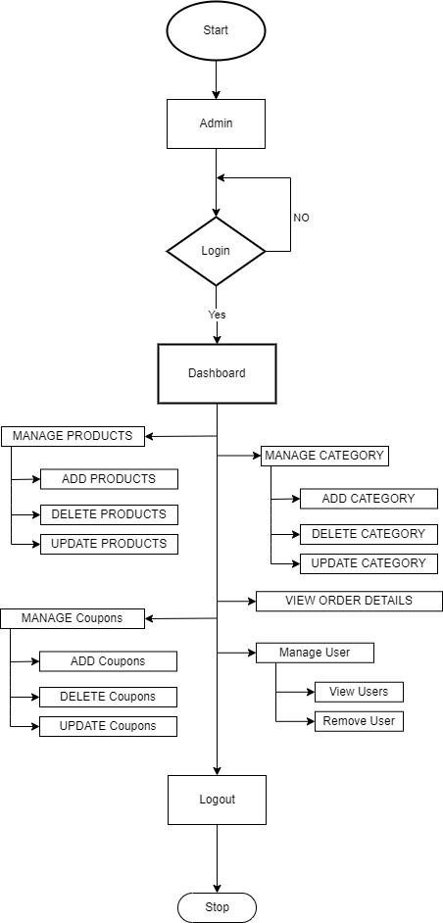
System Flow Diagram
Flow Chart (Admin)

Slide 9
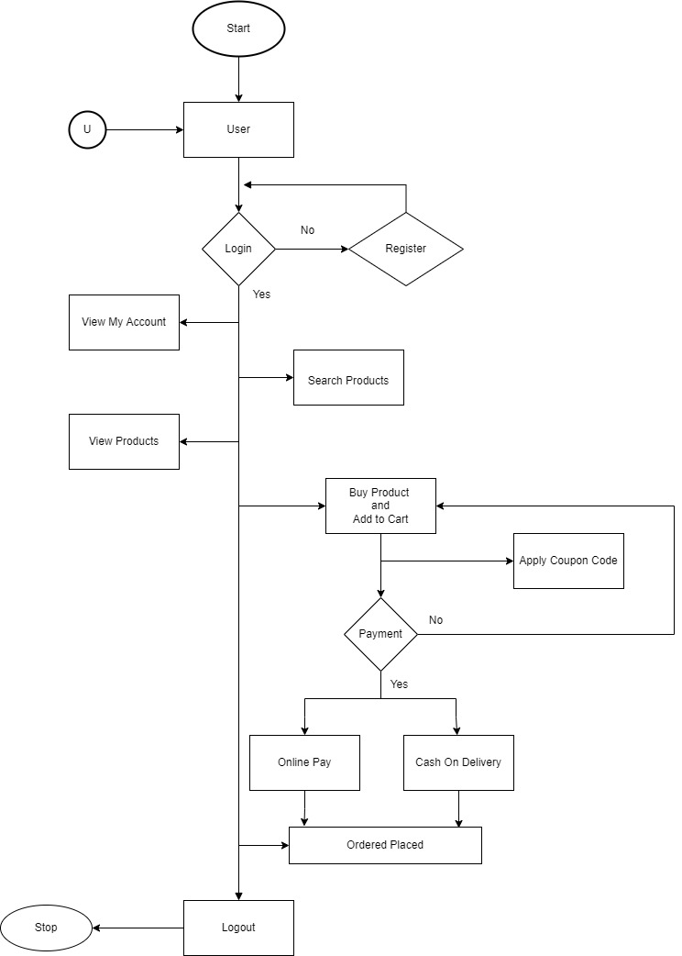
System Flow Diagram
Flow Chart (User)

Slide 10
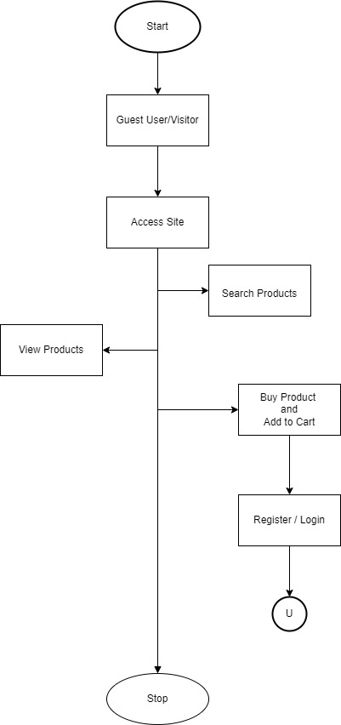
System Flow Diagram
Flow Chart (Guest user)

Slide 11
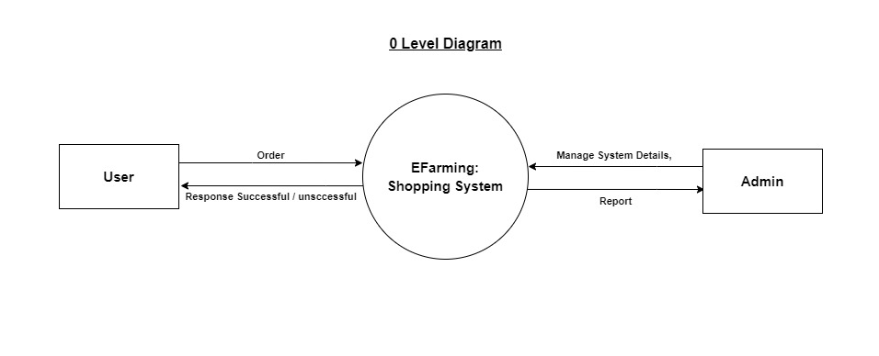
System Flow Diagram
DFD(Context Level / Level 0)

Slide 12
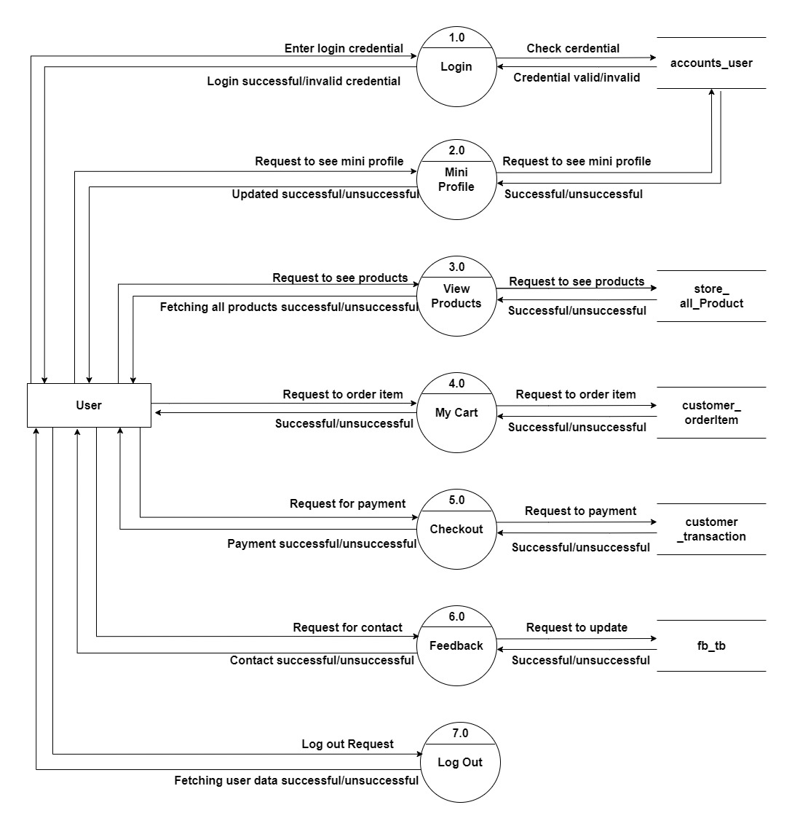
System Flow Diagram
DFD(Level 1 - User)

Slide 13
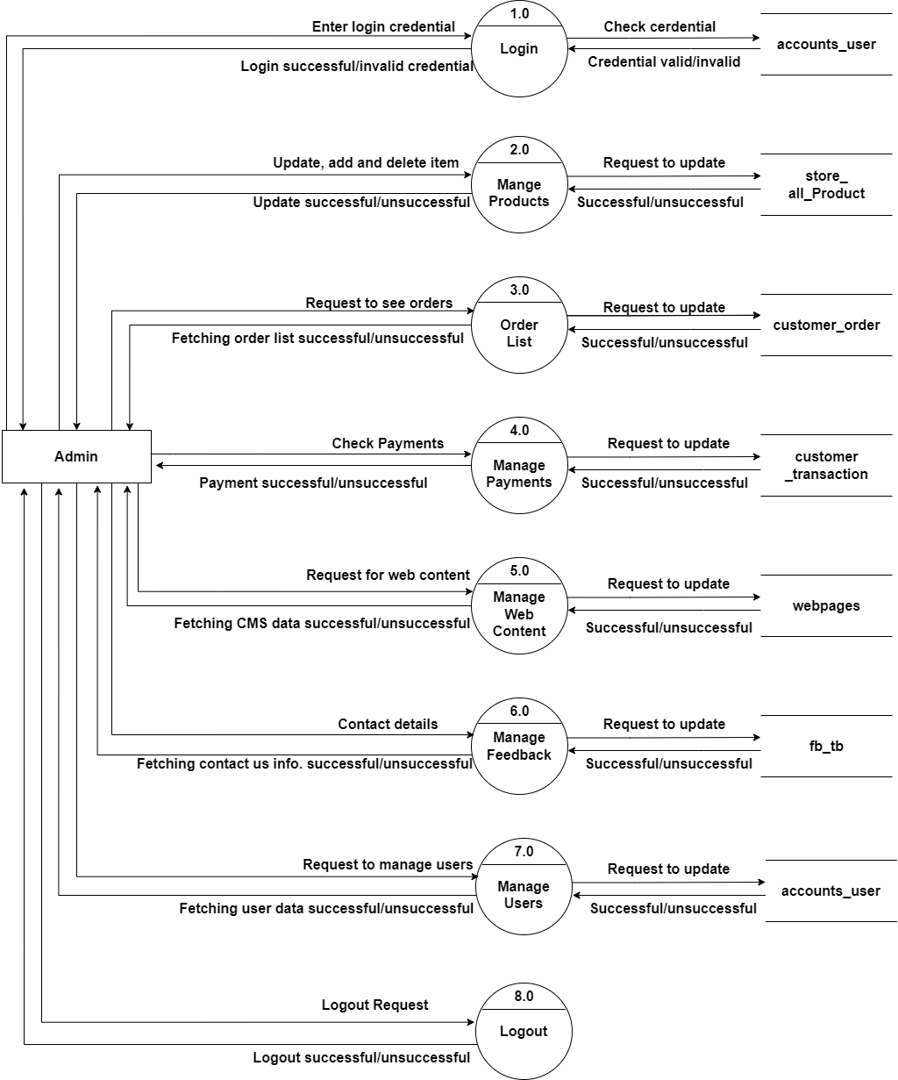
System Flow Diagram
DFD(Level 1 - Admin)

Slide 14
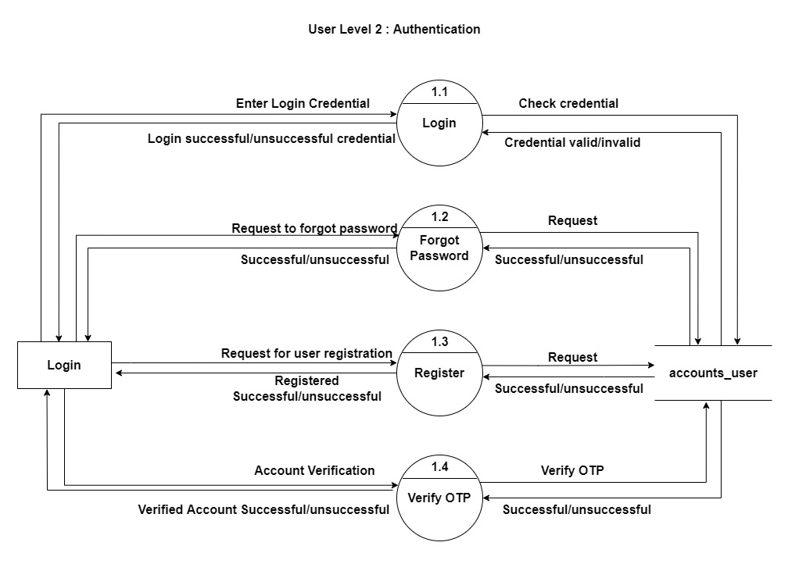
System Flow Diagram
DFD Level-2 (User)

Slide 15
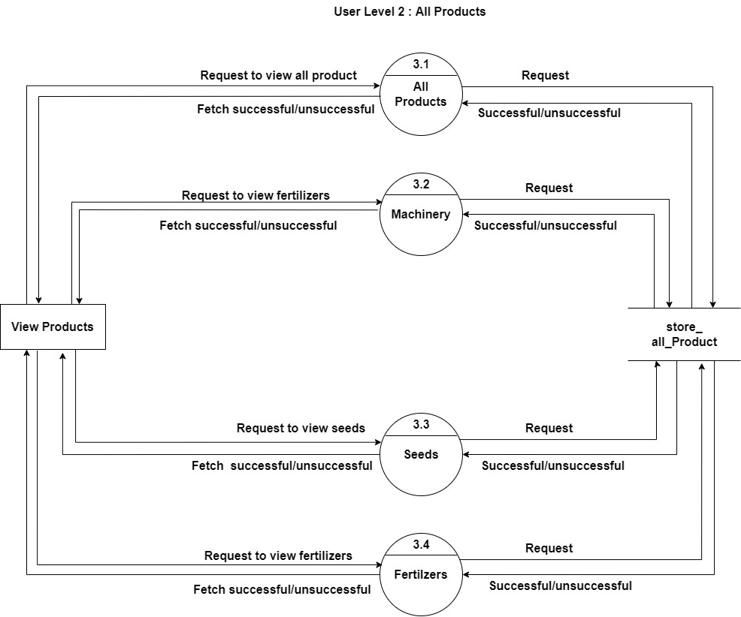
System Flow Diagram
DFD Level-2 (User)

Slide 16
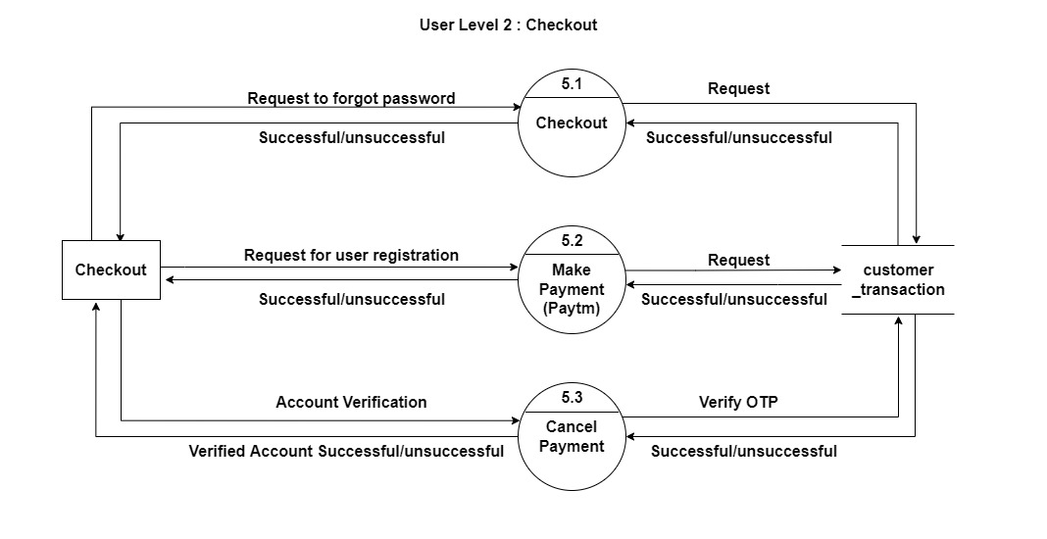
System Flow Diagram
DFD Level-2 (User)

Slide 17
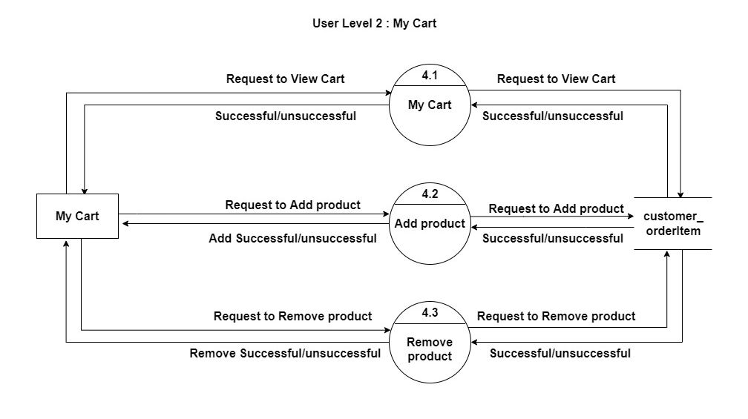
System Flow Diagram
DFD Level-2 (User)

Slide 18
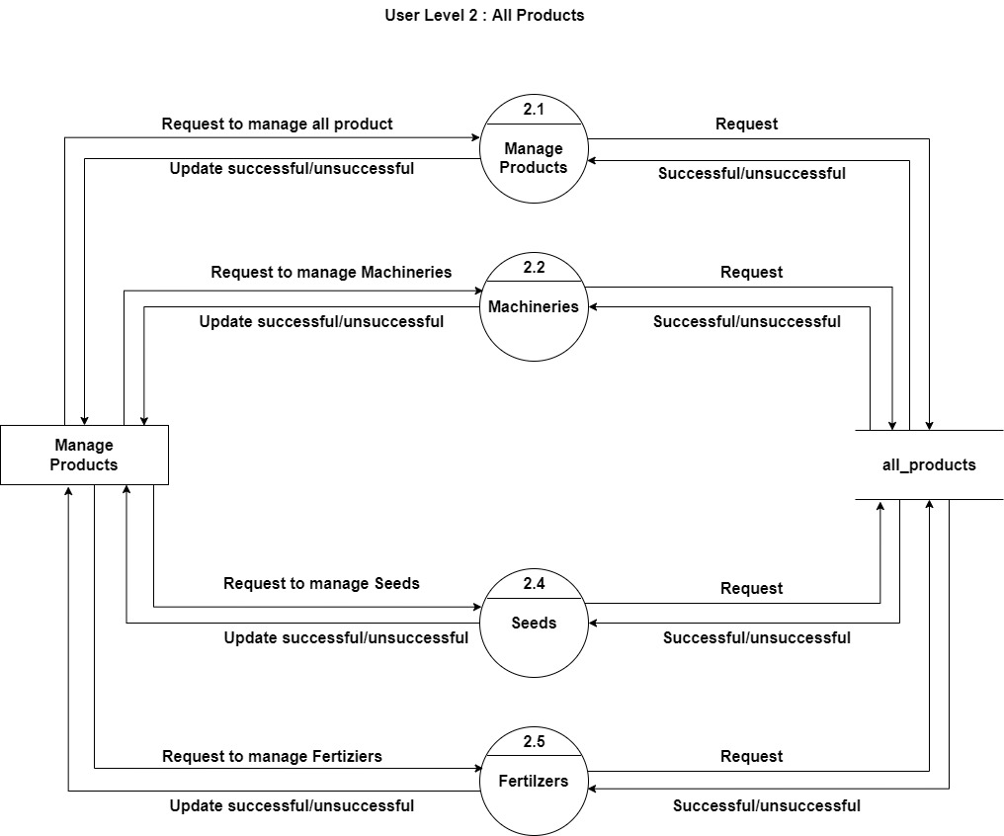
System Flow Diagram
DFD Level-2 (Admin)

Slide 19
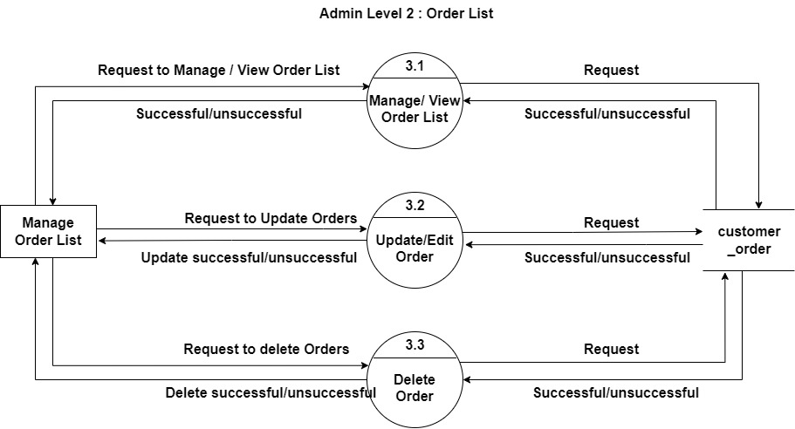
System Flow Diagram
DFD Level-2 (Admin)

Slide 20
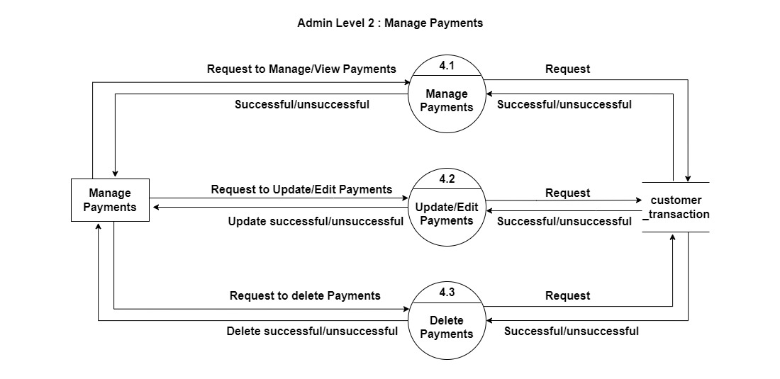
System Flow Diagram
DFD Level-2 (Admin)

Slide 21
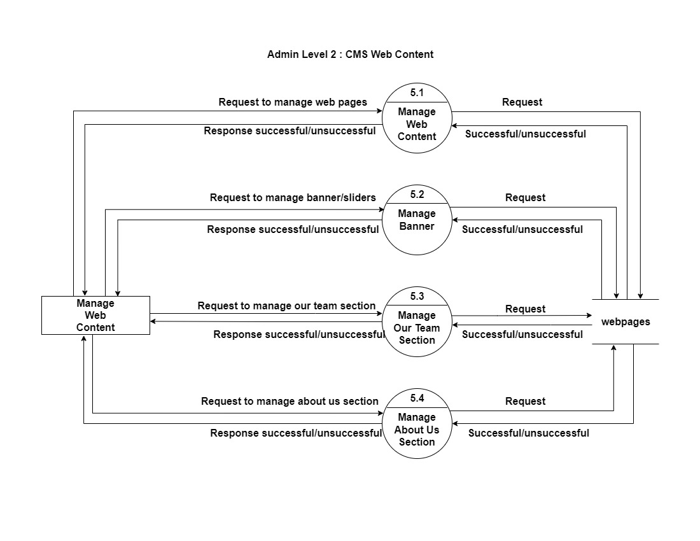
System Flow Diagram
DFD Level-2 (Admin)

Slide 22
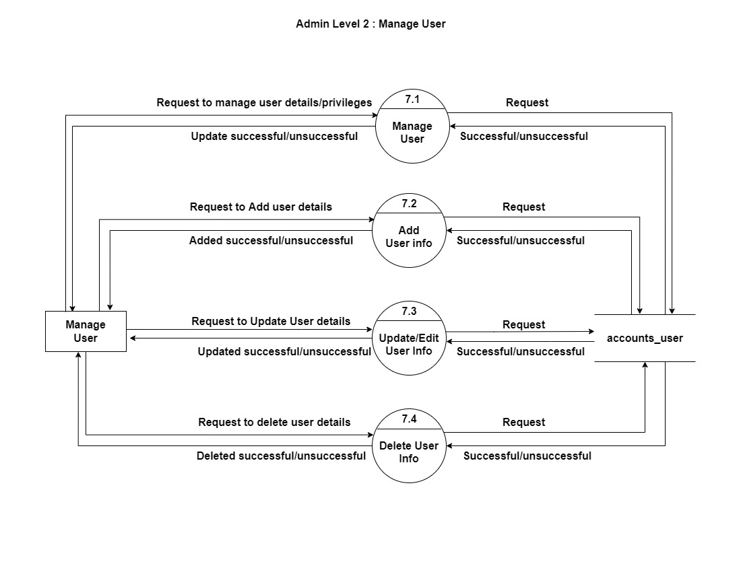
System Flow Diagram
DFD Level-2 (Admin)

Slide 23
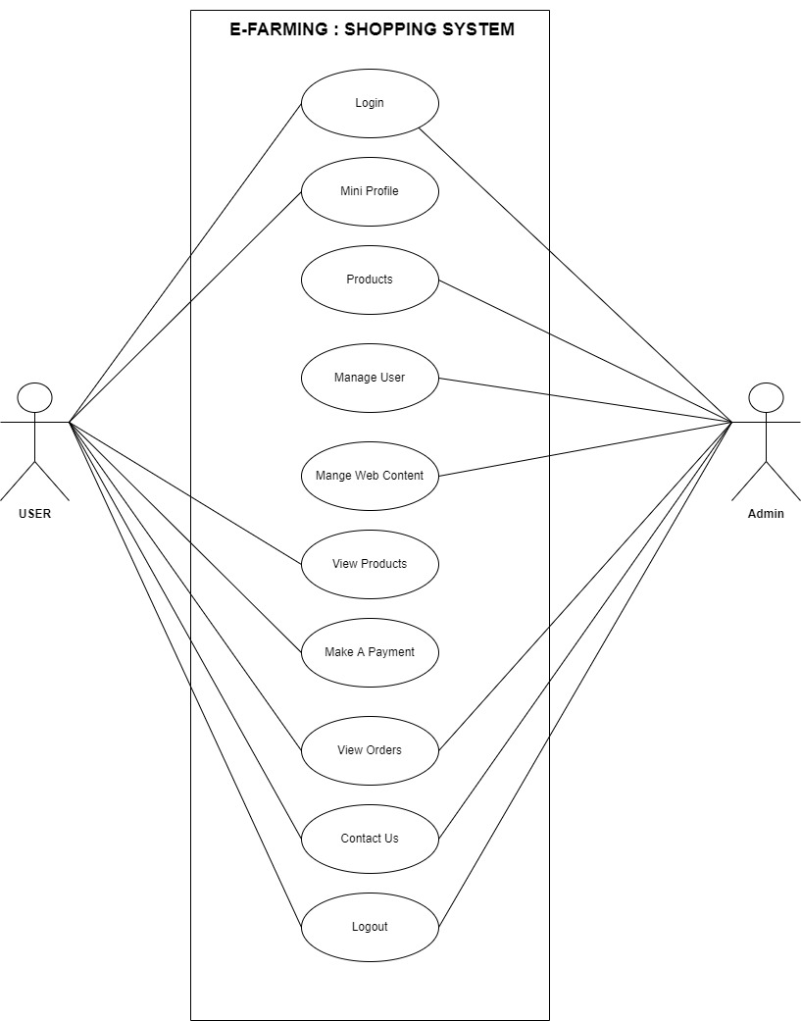
System Flow Diagram
Use case

Slide 24
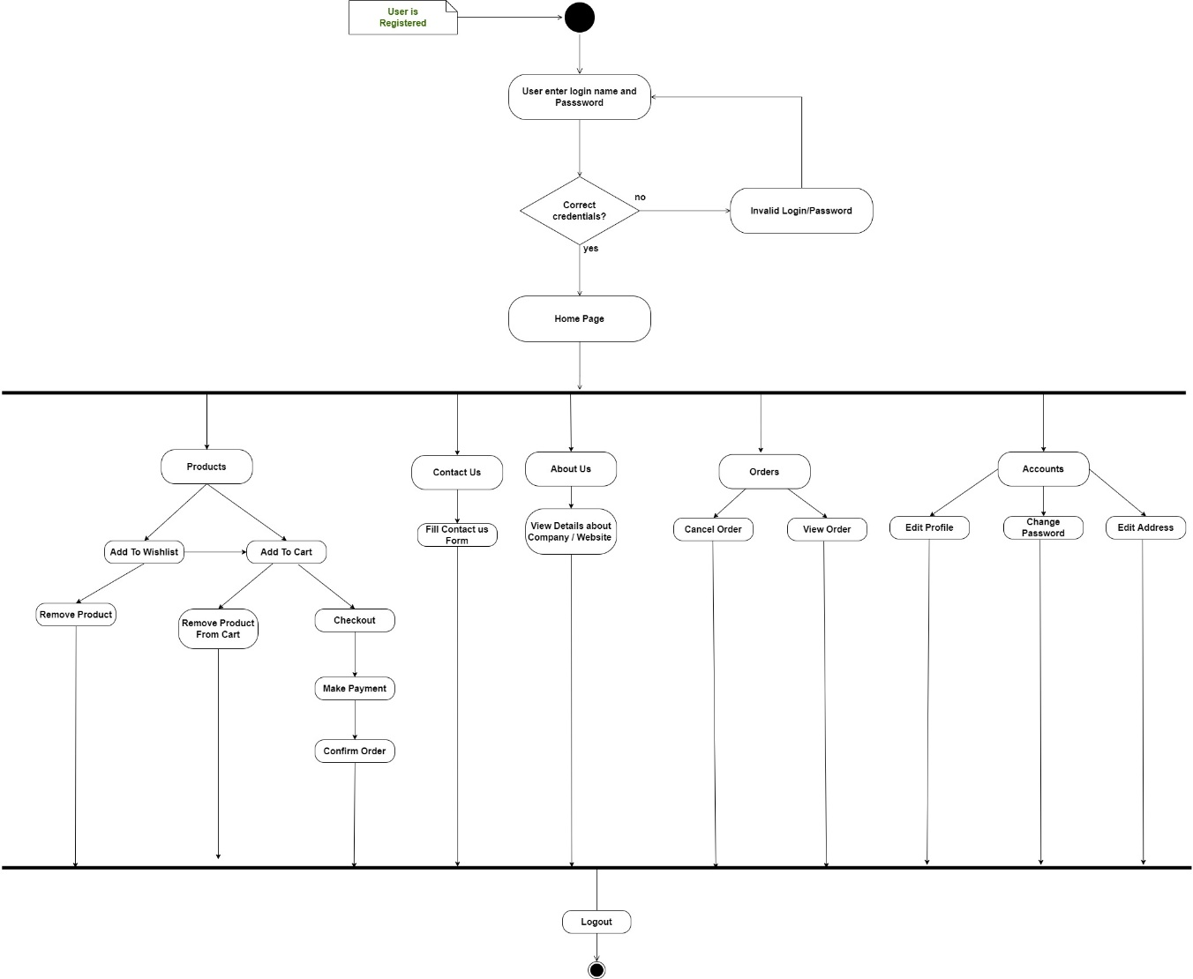
System Flow Diagram
Activity Diagram (User)

Slide 25
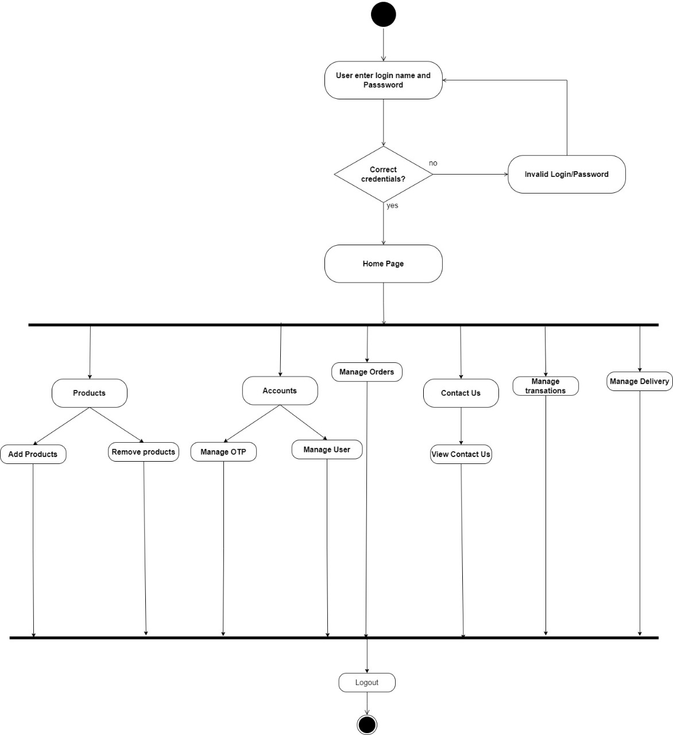
System Flow Diagram
Activity Diagram (Admin)

Slide 26
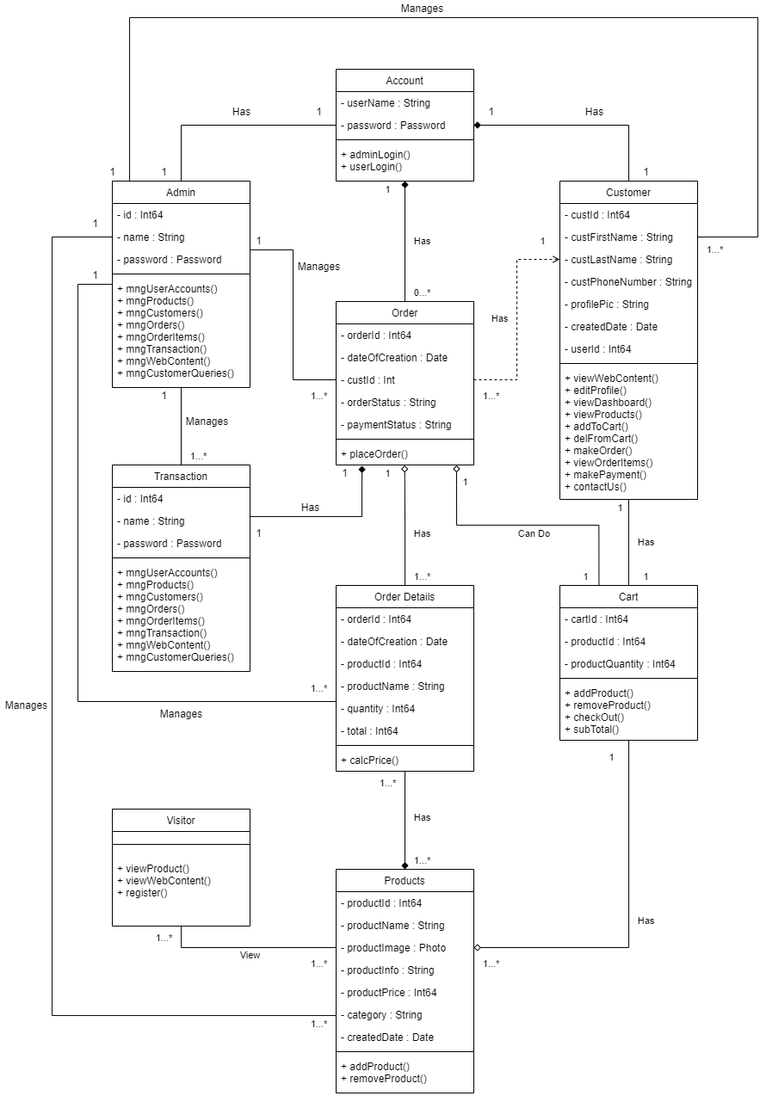
System Flow Diagram
Class Diagram

Slide 27
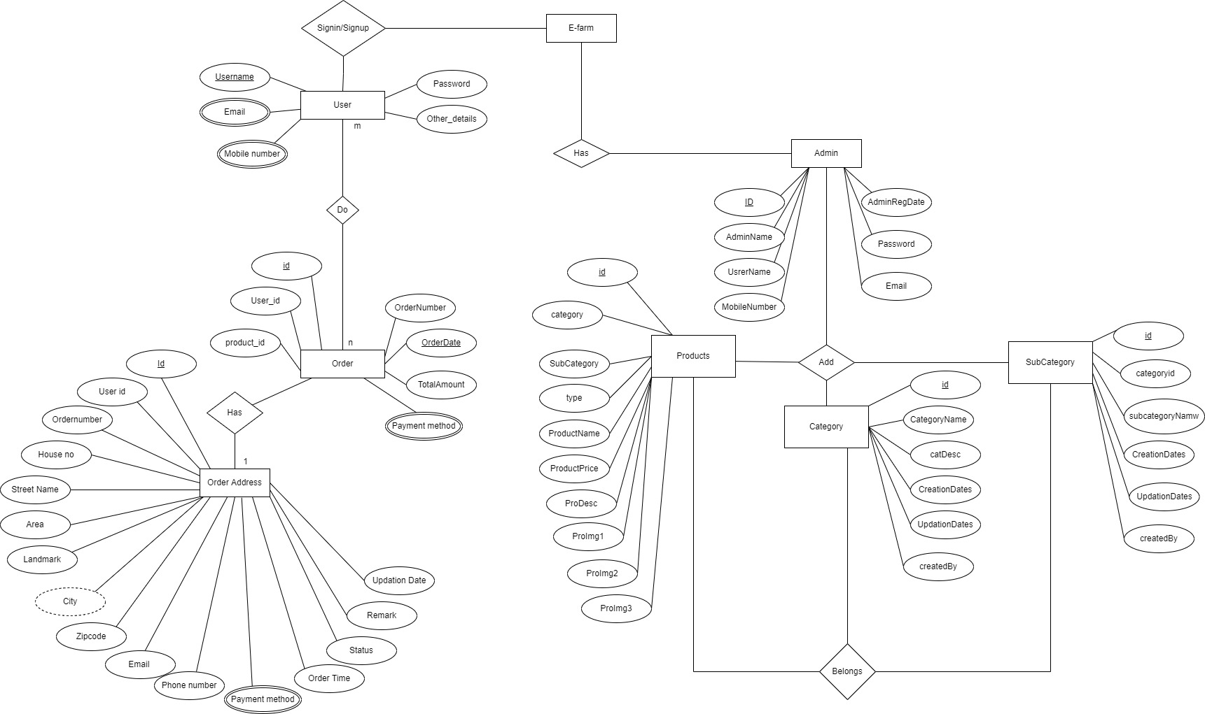
System Flow Diagram
ER Diagram

Slide 28
Data Dictionary
accounts_customuser Table
Sr. No | Field Name | Datatype | Size | Description | Constraint | Example
1 | last_login | timestamp | - | Primary Key | Unique id | 4
2 | is_superuser | boolean | - | Not Null | Is user user is admin or not | True / False
3 | username | Varchar | 10 | Not Null | user unique name | Virat67
4 | first_name | varchar | 15 | Not Null | Firest Name of User | Virat
5 | last_name | varchar | 15 | Not Null | Last Name Of user | Kohli
6 | email | varchar | 25 | Not Null | User Email Id | abc@gmail.com
7 | is_staff | boolean | - | Not Null | Is user is staff | True / False
8 | is_active | boolean | - | Not Null | Is user Is active or not | True / False
9 | date_joined | timestemp | - | Not Null | Date time of user | 2022-09-10
10 | phone | varchar | 10 | Null | User phone number | 7423658910
11 | is_verified | boolean | - | Not Null | Is user is verified or not | True / False
12 | Password | Varchar | 128 | Not Null | Password of the account | *********

Slide 29
Data Dictionary
accounts_otpcode
Sr. No | Field Name | Datatype | Size | Description | Constraint | Example
1 | id | bigint | - | Primary Key, AI | Unique id | 4
2 | number | varchar | 5 | Not Null | Otp Number of user | 14569
3 | User_id | bigint | - | Foreign Key | Foreign Key from coustomer table | 9

Slide 30
Data Dictionary
customer_customer Table
Sr. No | Field Name | Datatype | Size | Constraint | Description | Example
1 | Id | Bigint | - | Primary Key, AI | Unique id of this table | 2
2 | First_name | Varchar | 255 | NOT NULL | First name of Customer | Virat
3 | Last_name | Varchar | 255 | NOT NULL | Last name of Customer | Kohli2
4 | Phone_no | Bigint | - | NOT NULL | Phone number of the User | 9875524456
5 | User_id | Int | - | Foreign Key | (Foreign Key = id {From User Login Table (OneToOne Relationship)}) | 7
6 | Email | Varchar | 255 | NOT NULL | User Email Id | luk@123@gmail.com
7 | Shipping_address | bigint | - | Foreign Key | Foreign Key from Shpping_Sddress table | 2

Slide 31
Data Dictionary
Store_all_product Table
Sr. No | Field Name | Datatype | Size | Constraint | Description | Example
1 | Id | Bigint | - | Primary Key | Unique id | 4
2 | Photo | Varchar | 100 | NOT NULL | Photo of the item | store/product/2022/item1.jpg
3 | Product name | Varchar | 255 | NOT NULL | Name of the item | Multi Harvester
4 | Description | Varchar | 255 | NOT NULL | Product Info | Item Description
5 | Original_Price | Integer Field | - | NOT NULL | Product Price | 100
6 | Created date | Timestamp with time zone | - | NOT NULL | Date of updating that Product | 2022-02-07 16:15:35.346967+05:30
7 | Category | Varchar | 255 | NOT NULL | Machinery, Crops, Fertilizers, Seeds | Machinery
8 | On sale | boolen | - | Null | Product on sale | True
9 | Is_featured | boolen | - | Null | Product on feature | True
10 | After_discount_price | int | - | Null | Product price after discount | 5000
11 | Discount_amount | int | - | Null | Discount Amount in price | 1500
12 | Discount | varchar | 5 | Not Null | Discount Percentage | Default = ‘0%’

Slide 32
Data Dictionary
accounts_order
Sr. No | Field Name | Datatype | Size | Constraint | Description | Example
1 | id | bigint | - | Primary Key,AI | Unique id | 4
2 | Date_ordered | timestamp | - | Not Null | Order date | 2022-09-12
3 | Complete | boolen | - | Not Null | Order is complated ot not | True / False
4 | Order_number | varchar | 15 | Not Null | Order number | 5467845
5 | Order_status | varchar | 25 | Not Null | Order status | Pending
6 | Payment_status | varchar | 15 | Not Null | Payment done or not | Pending
7 | Order_made | int | 5 | Not Null | Order method | 1
8 | Shipping_method | varchar | 15 | Not Null | Shpping method | standerd method
9 | Dailivery_status | varchar | 25 | Not Null | Delivery status | In Progress
10 | Refuned_amount | varchar | 15 | Not Null | Refunded ammount | 0
11 | Customer_id | varchar | 10 | Foreign Key | Foreign Key from coustomer table | 12

Slide 33
Data Dictionary
customer_orderitem Table
Sr. No | Field Name | Datatype | Size | Constraint | Description | Example
1 | id | Bigint | - | Primary Key, AI | Unique id of this table | 2
2 | quantity | Int | - | NOT NULL | Quantity of Product | 2
3 | created_Date | Timestamp with time zone | - | NOT NULL | Creating date | 2022-02-07 16:15:35.346967+05:30
4 | Order_id | Bigint | - | Foreign Key | Foreign Key from order table | 5
5 | Product_id | Bigint | - | Foreign key | Foreign key from product table | 8
6 | Customer_id | bigint | - | Foreign Key | Foreign Key from coustomer table | 12
7 | Delivery | varchar | 25 | Not Null | Shows the delivery status | In Progress

Slide 34
Data Dictionary
customer_shippingaddress
Sr. No | Field Name | Datatype | Size | Constraint | Description | Example
1 | id | bigint | - | Primary Key,AI | Unique id | 27
2 | email | varchar | - | Not Null | Get user email | shreekoshti199@gmail.com
3 | phone | bigint | - | Not Null | User phone nuber | 0987654321
4 | Address1 | varchar | 15 | Not Null | Floor/ Buildling | G-1, Dewang Building, Bhagyoday Society,
5 | Address2 | varchar | 25 | Not Null | Street | Daman Rd, Chala;
6 | landmark | varchar | 15 | Null | User landmark | Hanis Landmark
7 | city | varchar | 5 | Not Null | User landmark | Pune
8 | state | varchar | 15 | Not Null | User state | Maharashtra
9 | zipcode | varchar |  | Not Null | User zipcode | 396191
10 | Shipping_method | varchar |  | Not Null | Get Shipping method | Standard Delivery
11 | Date_added | bigint |  | Not Null | Created date | 2022-09-11 22:04:29.094151+05:30
12 | Customer_id | bigint |  | Not Null | Foreign Key from customer table | 9
13 | Order_Id | bigint | - | Not Null | Foreign Key from Order table | 17

Slide 35
Data Dictionary
accounts_deliverystatus
Sr. No | Field Name | Datatype | Size | Description | Constraint | Example
1 | id | bigint | - | Primary Key,AI | Unique id | 4
2 | Delivary_status | varchar | 50 | Not Null | Order Status | Order shipped
3 | Customer_id | varchar | 10 | Foreign Key | Foreign Key from coustomer table | 14
4 | Order_id | varchar | 15 | Foreign Key | Foreign Key from orders table | 5
5 | Shipping_id | varchar | 5 | Foreign Key | Foreign Key from shippingaddress table | 3
6 | Transation_id_id | varchar | 15 | Foreign Key | Foreign Key from transations table | 13

Slide 36
Data Dictionary
customer_transaction
Sr. No | Field Name | Datatype | Size | Constraint | Description | Example
1 | id | bigint | - | Primary Key,AI | Unique id | 1
2 | Made_on | timestamp | - | Not Null | Admin response to the return request | 2022-09-12 19:46:38.231652+05:30
3 | amount | integer | - | Foreign Key | Foreign Key from customer table | 5906
4 | Transaction_id | varchar | - | Foreign Key | Foreign Key from delivery status table | PAY2ME20220912ODR28
5 | checksum | varchar | - | Foreign Key | Foreign Key from order table | C4Cp3k1YrccsLwh5
6 | result | varchar | - | Foreign Key | Foreign Key from product table | Success
7 | Payer_and_receiver | varchar | - | Foreign Key | Foreign Key from shipping table | Credit
8 | Made_by_id | bigint | - | Foreign Key | Foreign Key from Transaction table | 9
9 | Order_id | bigint | - | Foreign Key | Foreign Key from Order table | 22

Slide 37
Data Dictionary
customer_returnorder_request
Sr. No | Field Name | Datatype | Size | Constraint | Description | Example
1 | id | bigint | - | Primary Key,AI | Unique id | 4
2 | response | varchar | - | Not Null | Admin response to the return request | Accepted
3 | Customer_Id | bigint | - | Foreign Key | Foreign Key from customer table | 1234
4 | Delivery_status_Id | bigint | 15 | Foreign Key | Foreign Key from delivery status table | 9876
5 | Order_Id | bigint | 25 | Foreign Key | Foreign Key from order table | 45677
6 | Product_Id | bigint | 15 | Foreign Key | Foreign Key from product table | 12
7 | Shipping_address_Id | bigint | 5 | Foreign Key | Foreign Key from shipping table | standard method
8 | Transaction_id | bigint | 15 | Foreign Key | Foreign Key from Transaction table | PAY2ME2002

Slide 38
Data Dictionary
Webpages_homeslider
Sr. No | Field Name | Datatype | Size | Constraint | Description | Example
1 | id | Bigint | - | Primary Key, AI | Unique id of this table | 2
2 | title | Varchar | 100 | NOT NULL | Name of the Customer | Vladimir Punit
3 | description | Varchar | 255 | NOT NULL | Email Id of the Customer | xyz@example.com
4 | Btn_text | Varchar | 255 | NOT NULL | Subject of the Query | About stock of Forge Morage
5 | image | Varchar | 500 | NOT NULL | Query Content | I wanted to buy the machinery but the product is not in stock can you please let me know when it is available.
6 | Created_date | timestamp | - | Not Null | Entry created date | 2022-09-12 19:46:38.231652+05:30

Slide 39
Data Dictionary
Webpages_our_team Table
Sr. No | Field Name | Datatype | Size | Description | Constraint | Example
1 | id | bigint | - | Primary Key | Unique id of this table | 2
2 | First_name | Varchar | 255 | NOT NULL | First name of user | ABC
3 | Last_name | Varchar | 255 | NOT NULL | Last name of user | XYZ
4 | desc | Varchar | 255 | NOT NULL | Description | 5
5 | Designation | Varchar | 255 | NOT NULL | Designation | Admin
6 | Twitter_link | Varchar | 255 | NOT NULL | Hyper link of twitter | https://twitter.com/
7 | Fb_link | Varchar | 255 | NOT NULL | Hyper link of Facebook | https://facebook.com/
7 | LinkedIn_link | Varchar | 255 | NOT NULL | Hyper link of LinkedIn | https://linkedin.com/
8 | photo | Varchar | 100 | NOT NULL | Path of the photo | Image

Slide 40
Data Dictionary
Contact_Us_contact_mail
Sr. No | Field Name | Datatype | Size | Constraint | Description | Example
1 | id | Bigint | - | Primary Key | Unique id of this table | 2
2 | name | Varchar | 100 | NOT NULL | Name of the Customer | Vladimir Punit
3 | email | Varchar | 255 | NOT NULL | Email Id of the Customer | xyz@example.com
4 | subject | Varchar | 255 | NOT NULL | Subject of the Query | About stock of Forge Morage
5 | description | Varchar | 500 | NOT NULL | Query Content | I wanted to buy the machinery but the product is not in stock can you please let me know when it is available.

Slide 41
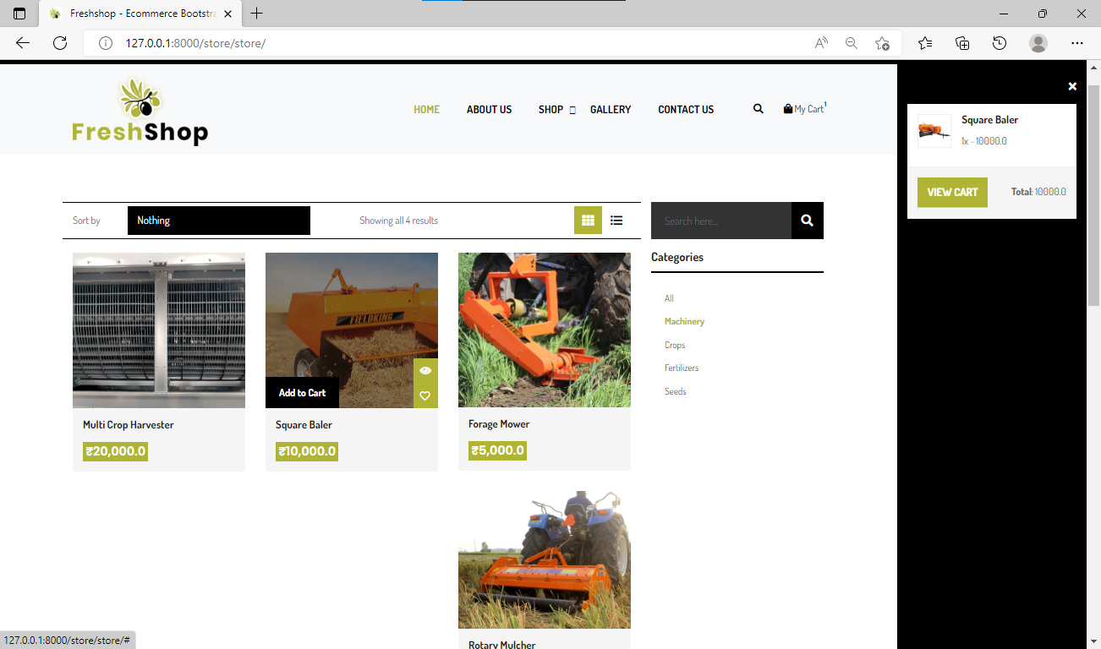
Screenshots of Development Phase 1

Slide 42
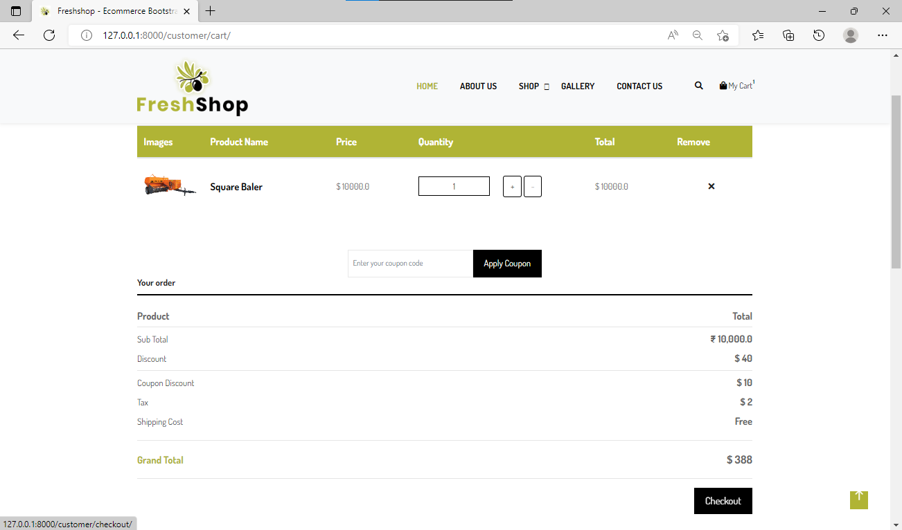
Screenshots of Development Phase 1

Slide 43
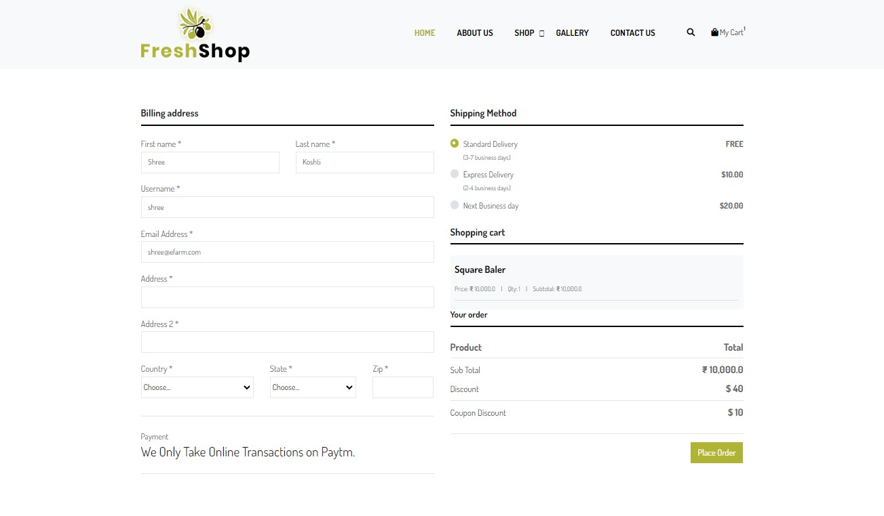
Screenshots of Development Phase 1

Slide 44
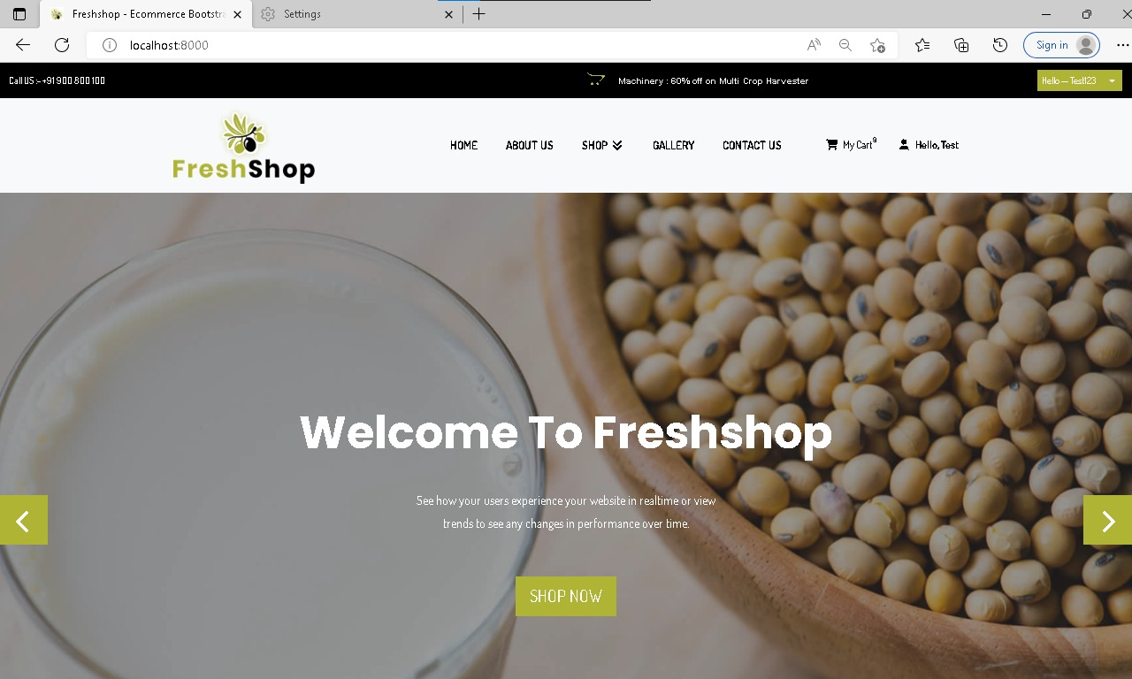
Screenshots of Development Phase 2

Slide 45
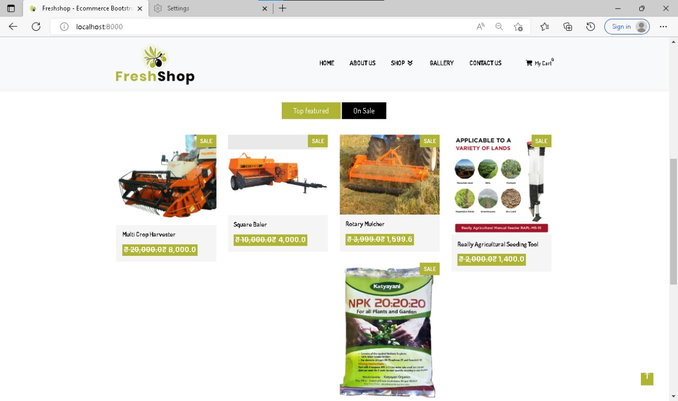
Screenshots of Development Phase 2

Slide 46
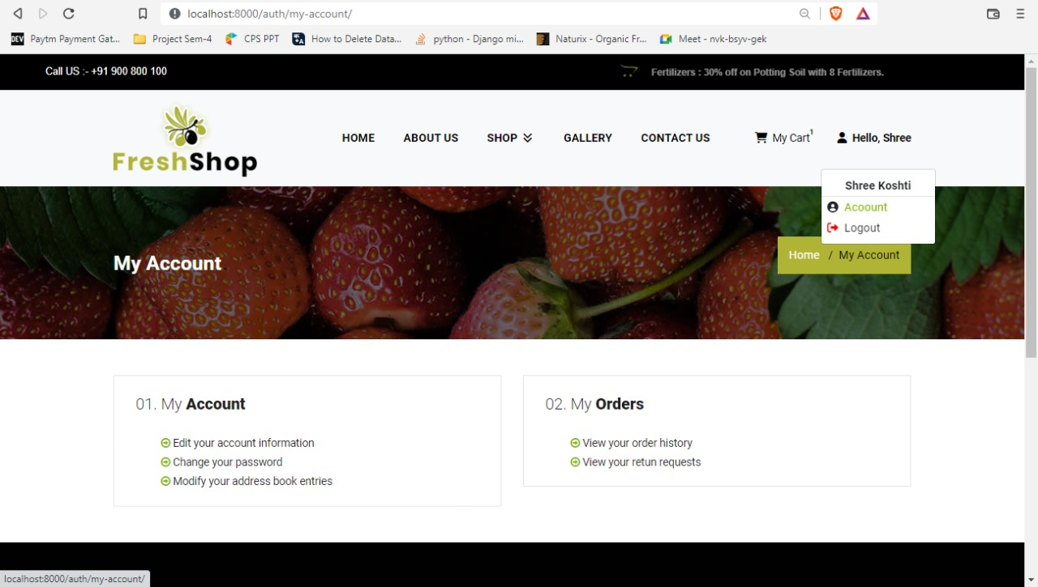
Screenshots of Development Phase 2

Slide 47
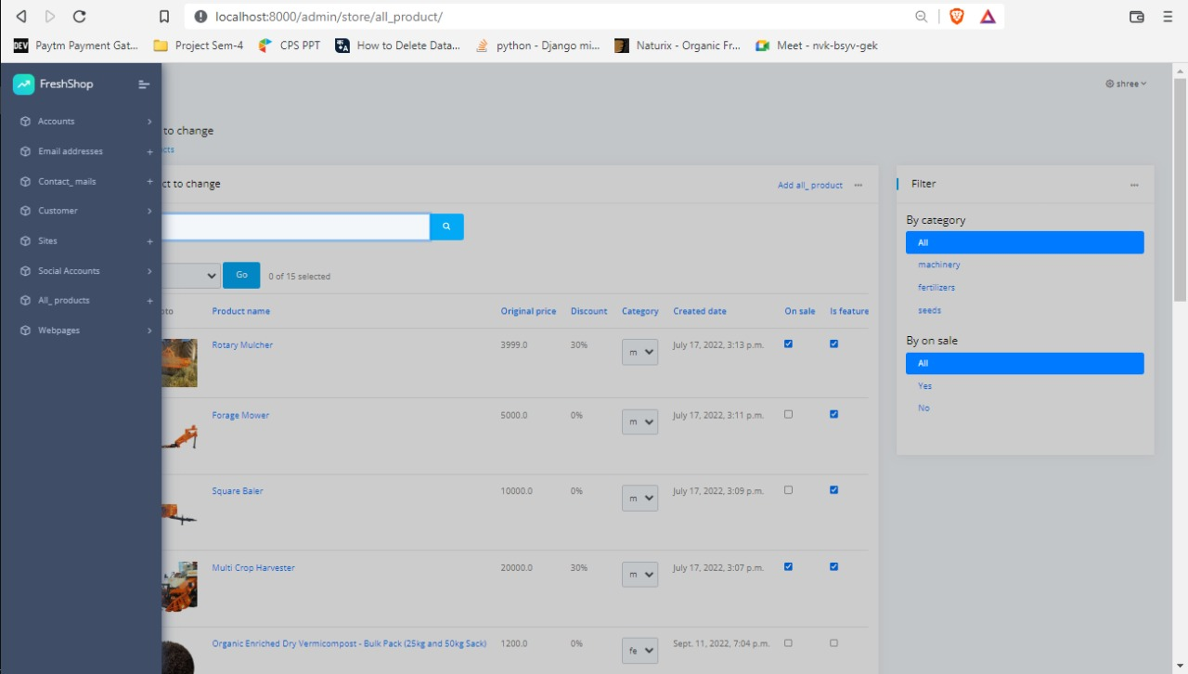
Screenshots of Development Phase 3

Slide 48
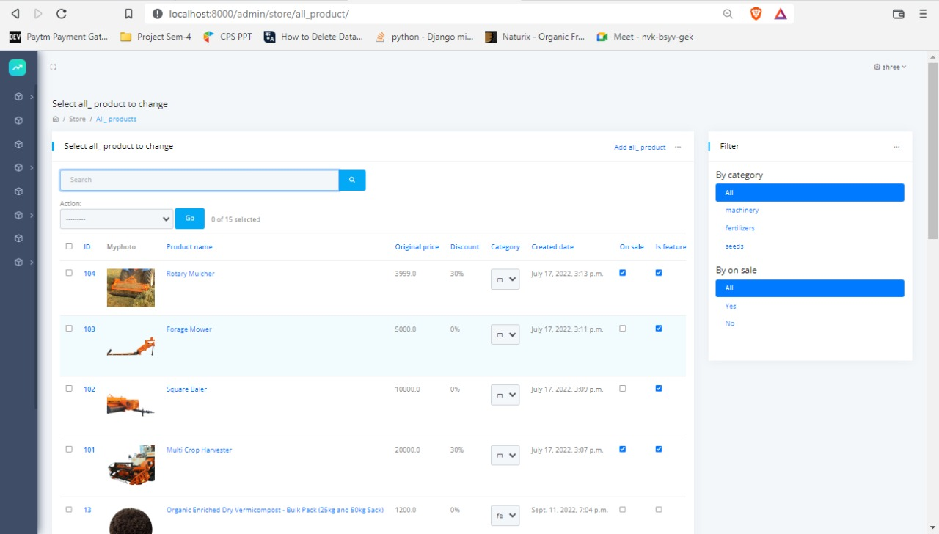
Screenshots of Development Phase 3

Slide 49
Screenshots of Development Phase 3

Slide 50
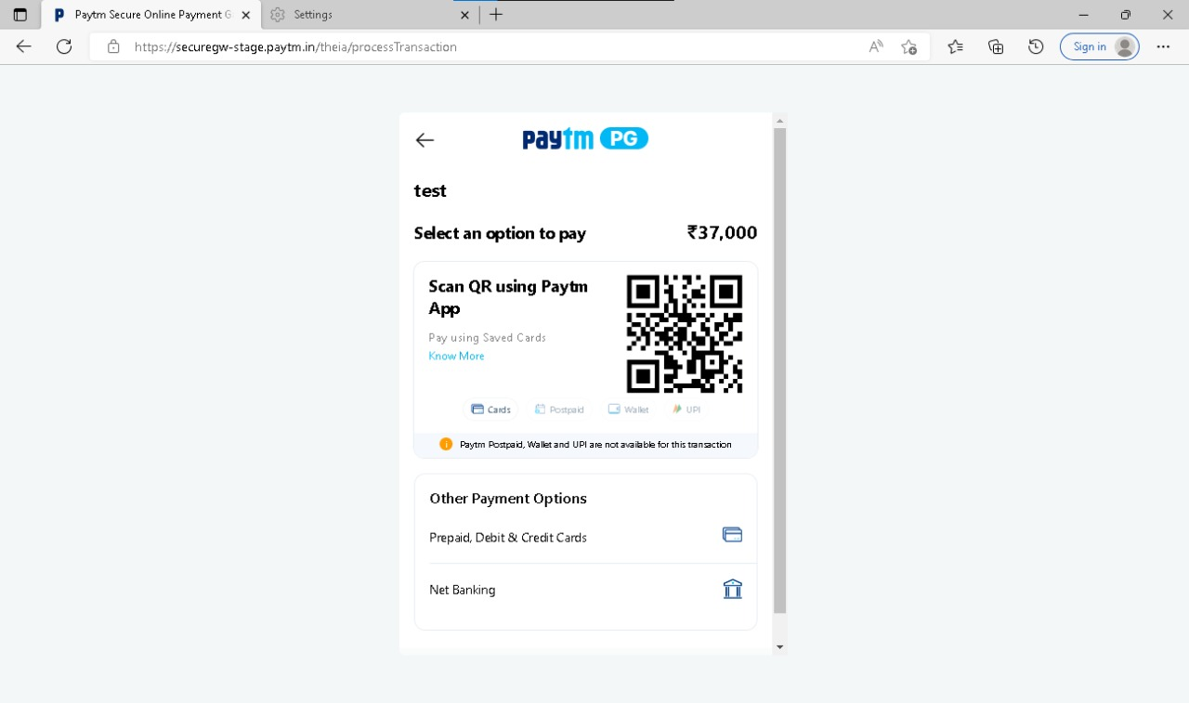
Screenshots of Development Phase 3

Slide 51
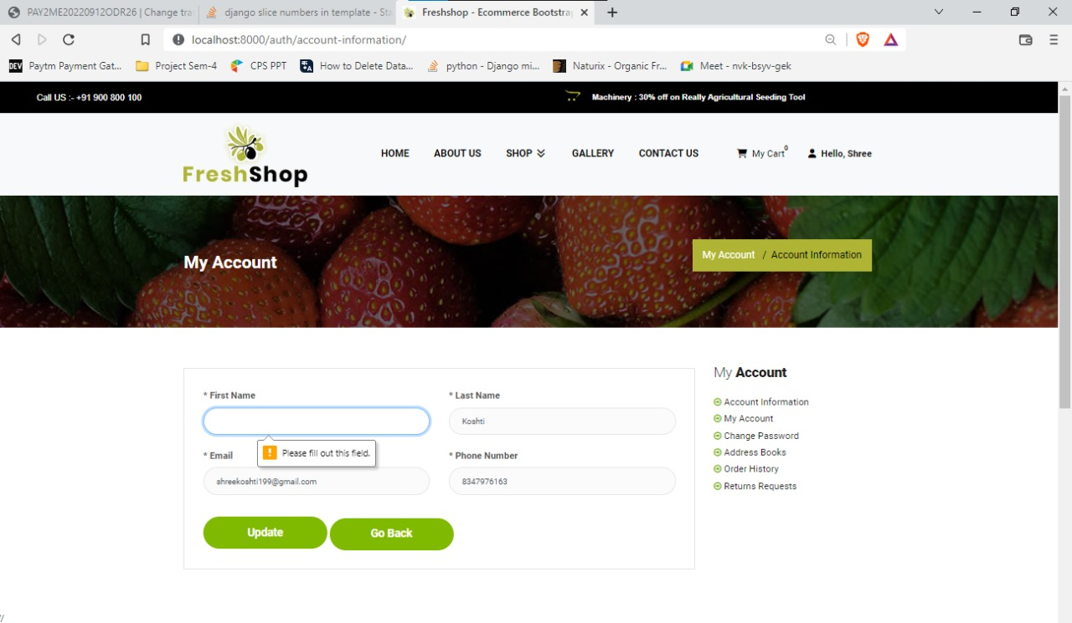
Screenshots of Validation

Slide 52
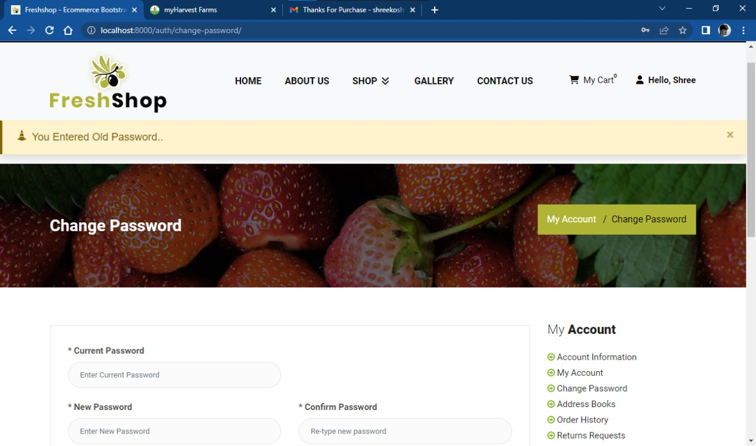
Screenshots of Validation

Slide 53
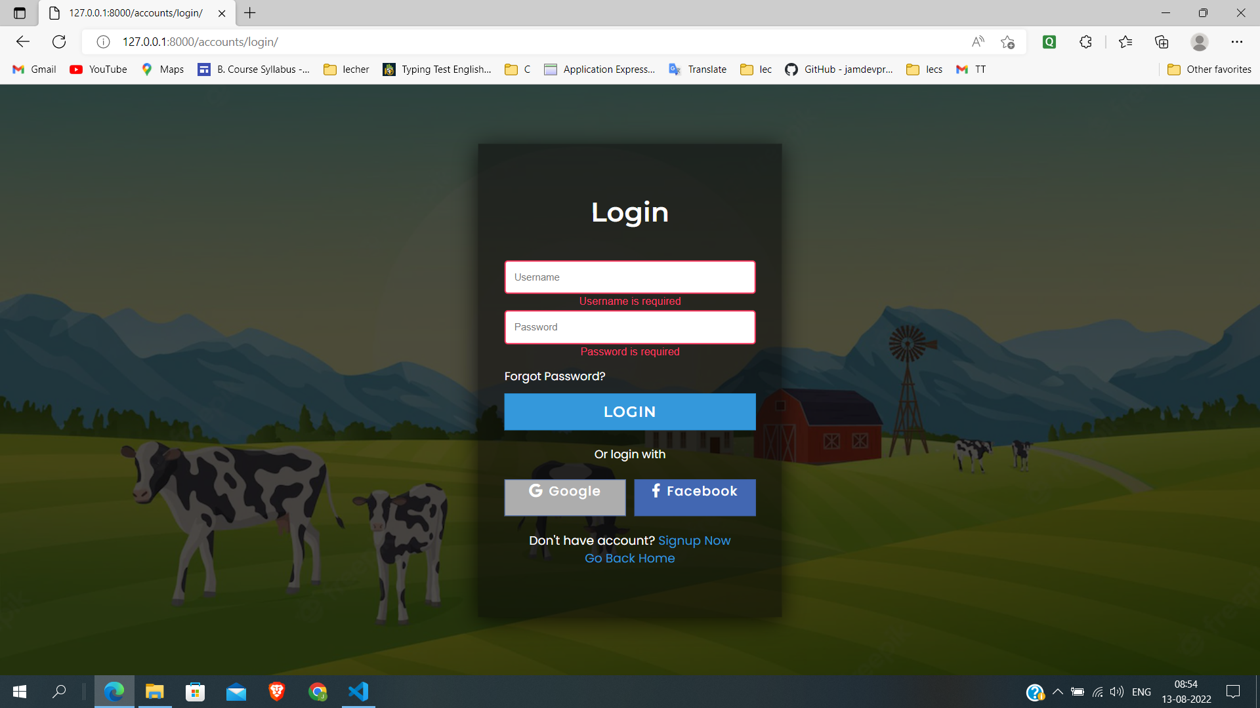
Screenshots of Validation

Slide 54
Conclusion
In conclusion, we have been able to make a really user-friendly project on the Django (Python).
Giving it a modern touch and easy to use platform. We have included the all the latest trendy
Items for the people to enjoy and come back to us again for a good quality. We really aim to make our system better and more advanced in the future. Our goal is to keep it more user friendly and accessible.
Our main aim was to keep it bug friendly so that the users don’t face any technical problems while ordering products.

Slide 55
Future Enhancement
Delivery status will be more efficient at user side
New more payment mode will add Ex, UPI ,COD.
Delivery status will be updated by delivery boy at mobile location
Make more user-friendly UI.
more enhanced admin side.
In future we will create android as well as IOS mobile application.

Slide 56
References
Website:
https://docs.djangoproject.com/en/3.2/
https://www.python.org/doc/
https://stackoverflow.com/
Book :
Django for Beginners: Build websites with Python and Django
(William S Vincent)
Think Python : How to Think Like a Computer Scientist
(Allen Downey)
The Elements of Uml (tm) 2.0 Style
(Scott W. Ambler)

Slide 57
Thank you !!!

